Slide 1
Suitable Activity suggestions via Kmeans

Slide 2
Clustering Data
metMinutes
timeStart
Duration
Age
Gender
Intensity

Slide 3
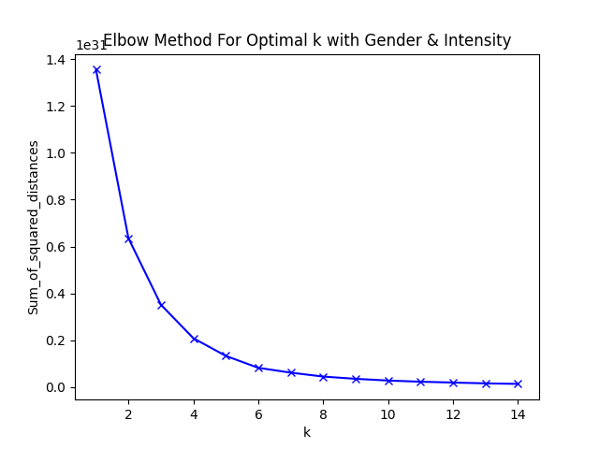
Clustering data
Six clusters

Slide 4
Suggest Excercise
Suggest excercises based on users in cluster
Break the cycle: Suggest not well liked excercises, so user can move to other clusters

